Slide 1

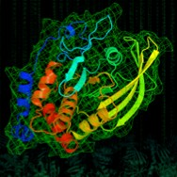







Introduction to Cori
Slides by Steve Leak
NERSC User Engagement Group
https://docs.nersc.gov/systems/cori/

Slide 2
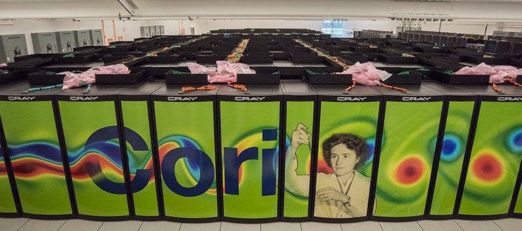
NERSC Cori
34 double-width cabinets
9,688 KNL + 2,388 Haswell nodes on Aries High-Speed Network
658,784 KNL cores + 76,416
Haswell cores
Top500 #6 (June 2017)

Slide 3
Agenda
Cori overview, logging in
Run a simple job
Building and running applications on Cori
Serial
Parallel (MPI)
Multithreaded (OpenMP)
What aﬀects performance?
Bottlenecks
Task placement and aﬃnity
Preparing for performance analysis

Slide 4
Cori overview, logging in

Slide 5
Before we start
The training materials are available on github: hZps://git.io/v7OuW (and hZps://git.io/v7LeY)
And also on Cori, via:
cd $SCRATCH
module load training/csgf-2017
git clone $TRAINING $SCRATCH/csgf-2017
The slides are available at ( hZps://www.nersc.gov/users/training/events/ csgf-2017-hpc-workshop)
This is a very hands-on oriented session
(so have laptops ready!)
We will pause for Q&A at the end of each topic

Slide 6
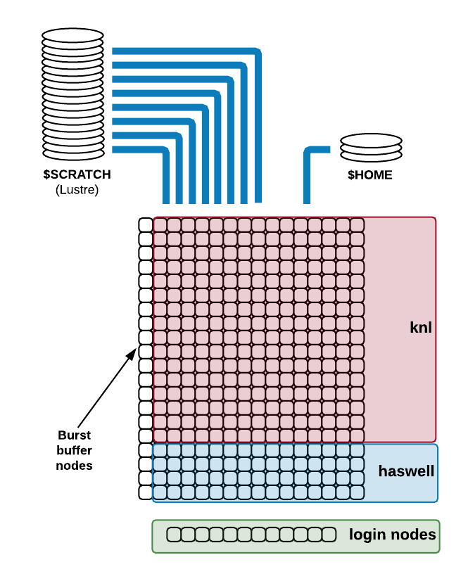
Cori Overview
Login and compute nodes are distinct
Large, fast, parallel
$SCRATCH ﬁlesystem for running jobs
Smaller $HOME, conﬁgured for building code
Burst buﬀer ﬁlesystem integrated, on high-speed network
Linux command: mount, lsblk,

Slide 7

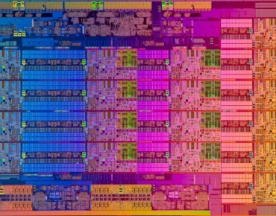


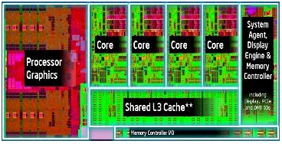


What’s so special about it?
Your quad-core desktop CPU looks something like this:
Compared to a Cori Haswell node:
16 cores
x 2 sockets, 128GB RAM
Images courtesy of Google Image Search, Intel, EnterpriseTech.com, NextPlaQorm.com

Slide 8


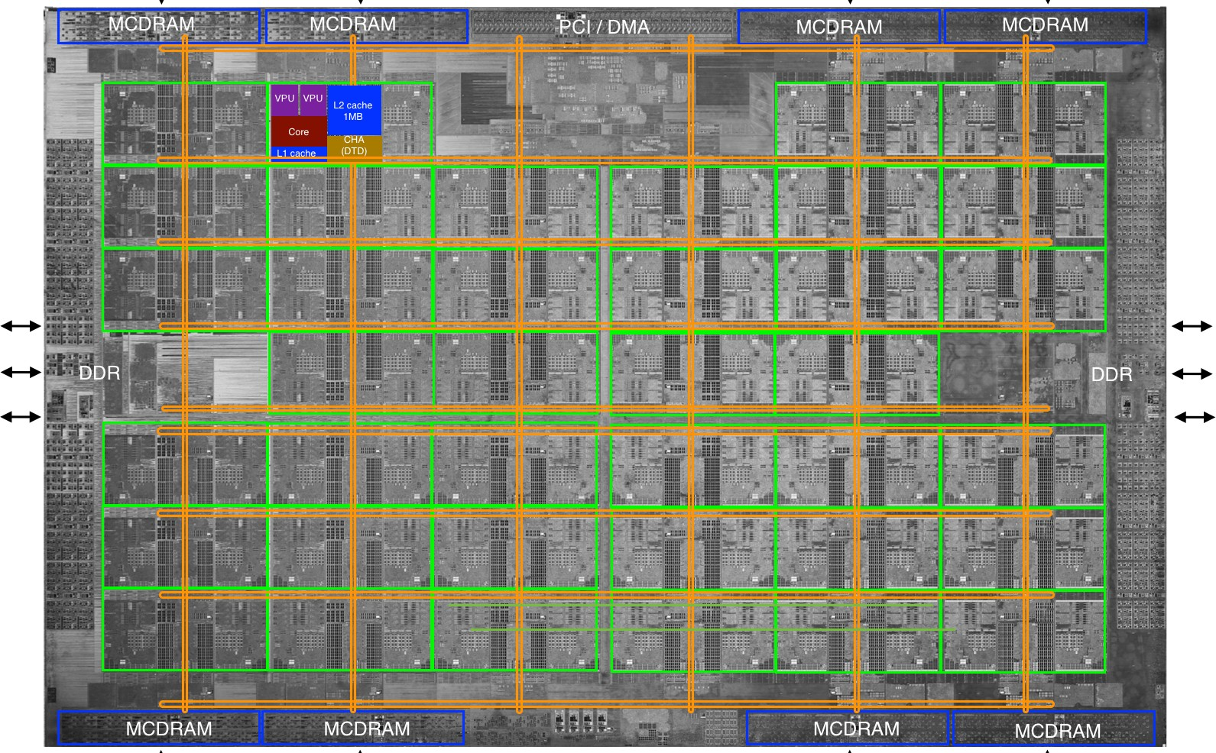

What’s so special about it?
And then there are the KNL nodes (68 cores, MCDRAM, …)

Slide 9
What’s so special about it?
But high-end CPUs don’t make a supercomputer
High speed interconnects between them
Lightweight compute node OS
Very large (28,000 TB) fast parallel ﬁlesystem
…and a diﬀerent usage model
Subset of nodes dedicated to a single task, run via batch system (no interactive GUI / desktop)

Slide 10
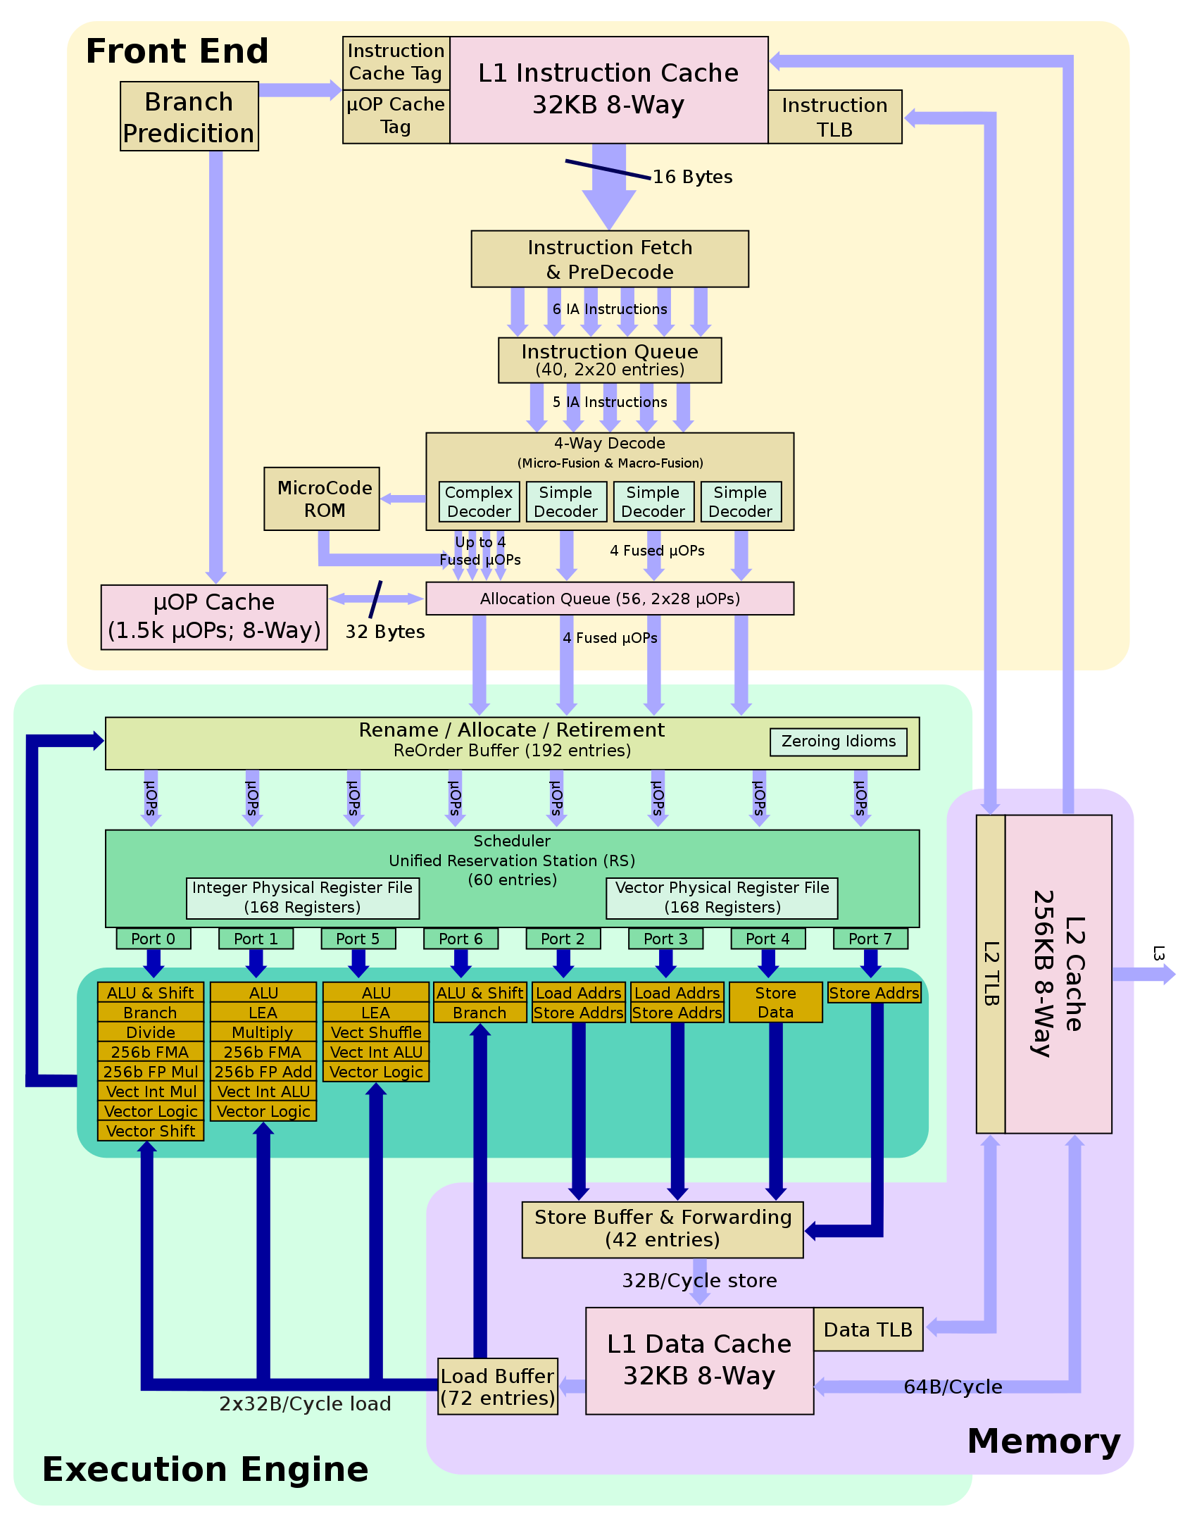









What’s special about KNL?
Diﬀerent choice of compromise between die space allocated to diﬀerent parts of the CPU
Instruction fetch-and- decode, hyperthreading, branching (important for eg compiling, GUI applications)
Memory access – keeps execution engine busy
Arithmetic, vector and ﬂoating point units – the actual FLOPS

Slide 11


















What’s special about KNL?
Xeon (eg Haswell)
Xeon Phi (KNL)
Large and fast
- power hungry, hot
Small and slow, cool, eﬃcient
Big wide vectors
Smaller space, shorter vectors
large L3 cache
Large L2 cache, no L3 (but MCDRAM)

Slide 12
Why?
Exascale challenges – power and heat
CPU frequency plateaued ~15 years ago
Transistor density, feature size reaching fundamental limits
Power consumption and heat dissipation are now the key constraints for supercomputing
KNL emphasizes vectorization and parallelism at lower power
Targets scientiﬁc computing

Slide 13
Cori Overview
Login and compute nodes are distinct
Large, fast, parallel
$SCRATCH ﬁlesystem for running jobs
Smaller $HOME, conﬁgured for building code
Burst buﬀer ﬁlesystem integrated, on high-speed network

Slide 14
Connecting to Cori
If you have a UNIX-like computer, you can directly contact NERSC with your built-in SSH client
Open a new terminal
% ssh –Y -l <training_acct_username> cori.nersc.gov
Many SSH clients exist for Windows
A very popular one is puZy, xshell (free for education)
hZp://www.puZy.org/
Advanced users might prefer to use SSH directly within minZy (from Cygwin distribution)
- 14 -
Notes:
-Y' Enables trusted X11 forwarding. Trusted X11 forwardings are not subjected to the X11 SECURITY extension controls.
Overview
The X Window System (also known as X11, or just X) is a software package and network protocol that lets you interact locally, using your personal computer's display, mouse, and keyboard, with the graphical user interface (GUI) of an application running on a remote networked computer.
You can use X forwarding in an SSH session on your personal computer to securely run graphical applications (X clients) installed on the Indiana University research supercomputers.
Requirements

Slide 15
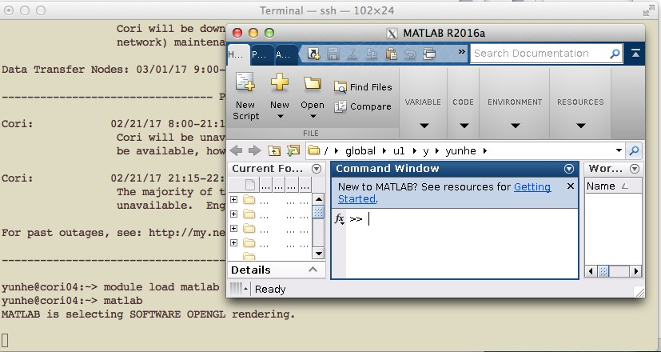
X-forwarding
Allows you to access GUI programs remotely
We will need it this apernoon!
Example:
localhost% ssh –Y -l elvis cori.nersc.gov
…
e/elvis> module load matlab e/elvis> matlab
<MATLAB starts up>
- 15 -

Slide 16



Example Session
localhost:~elvis> ssh –Y -l <training_account_name> cori.nersc.gov
*****************************************************************
* *
* *
* *
* *
Lawrence Berkeley National Laboratory operates this *
computer system under contract to the U.S. Department of *
Energy. This computer system is the property of the United *
States Government and is for authorized use only. *Users *
(authorized or unauthorized) have no explicit or implicit *
expectation of privacy.* *
* *
* *
* *
* *
* *
* *
* *
* *
* *
* *
* *
* *
* *
* *
* *
* *
* *
* *
Prompt on local system
NOTICE TO USERS
---------------
Notiﬁcation of acceptable use.
Any or all uses of this system and all files on this system may be intercepted, monitored, recorded, copied, audited, inspected, and disclosed to site, Department of Energy, and law enforcement personnel, as well as authorized officials of other agencies, both domestic and foreign. *By using this system, the user consents to such interception, monitoring, recording, copying, auditing, inspection, and disclosure at the discretion of authorized site or Department of Energy personnel.*
*Unauthorized or improper use of this system may result in administrative disciplinary action and civil and criminal penalties. _By continuing to use this system you indicate your awareness of and consent to these terms and conditions of use. LOG OFF IMMEDIATELY if you do not agree to the conditions stated in this warning._*
*****************************************************************
Password: <enter your training account password here>
Password prompt
- 16 -

Slide 17
After logging in…
On a login node
cori01, cori02, …
Shared by many users
Not necessarily the same one each time!
But same access to ﬁlesystems
No direct access to compute nodes
Only via batch system (salloc, sbatch)
Haswell (Xeon) architecture

Slide 18
Hands-on exercise
First: Q&A ?
Exercise: (check README.md at hZps://git.io/v7LeY)
Log in to Cori
Navigate to $SCRATCH
Load the module “training/csgf-2017”, this will set
$TRAINING to the location of the training materials.
Copy (or git-clone) the training materials to your $SCRATCH, and browse the ﬁles (especially ex1-getting_started/ README.md)
Is X working? Try to start an xterm
cori$ xterm &

Slide 19
Agenda
Cori overview, logging in
Run a simple job
Building and running applications on Cori
Serial
Parallel (MPI)
Multithreaded (OpenMP)
What aﬀects performance?
Bottlenecks
Task placement and aﬃnity
Preparing for performance analysis

Slide 20
Run a simple job
用起来

Slide 21
Running jobs – key points
HPC work is via batch system
Dedicated subset of compute resources
Login nodes are shared resource for building code, editing scripts, etc. Use batch jobs for real work
Key commands:
sbatch / salloc (yhbatch/yhalloc) - submit a job
srun (yhrun) - start an (optionally MPI) application within a job
sqs (yhq) - check the queue for my job status
For today, we have a reservation
#SBATCH –reservation=csgrrain
www.nersc.gov/users/computational-systems/cori/running-jobs/

Slide 22
Running jobs – key points
HPC work is via batch system
Dedicated subset of compute resources
Login nodes are shared resource for building code, editing scripts, etc. Use batch jobs for real work
Key commands:
All of this is
– sbatch / salloc - submit a job
on the web!
srun - start an (optionally MPI) application within a job
sqs - check the queue for my job status
For today, we have a reservation
– #SBATCH –reservation=csgrrain
www.nersc.gov/users/computational-systems/cori/running-jobs/

Slide 23
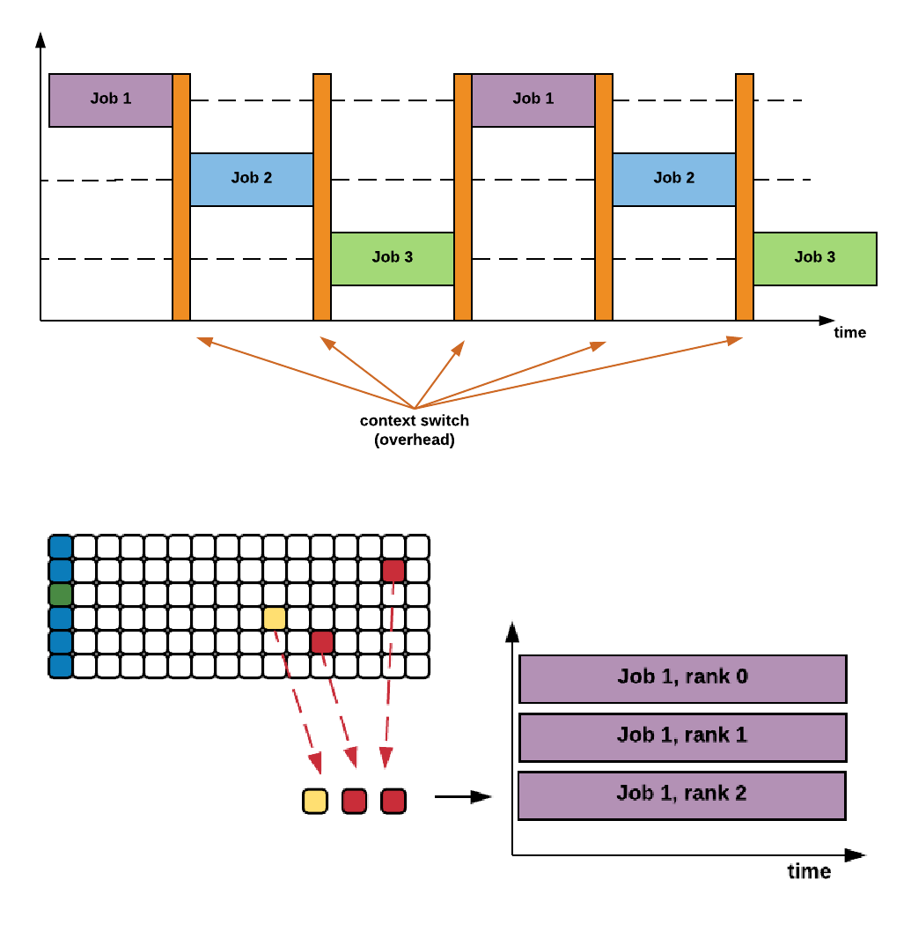

How jobs work
Desktop / login node
Timeslicing
core shared by multiple tasks
Works when the
computer is mostly waiting for you
HPC
You are waiting for the computer
Subset of pooled resources dedicated to one job
Submitting jobs

Slide 24
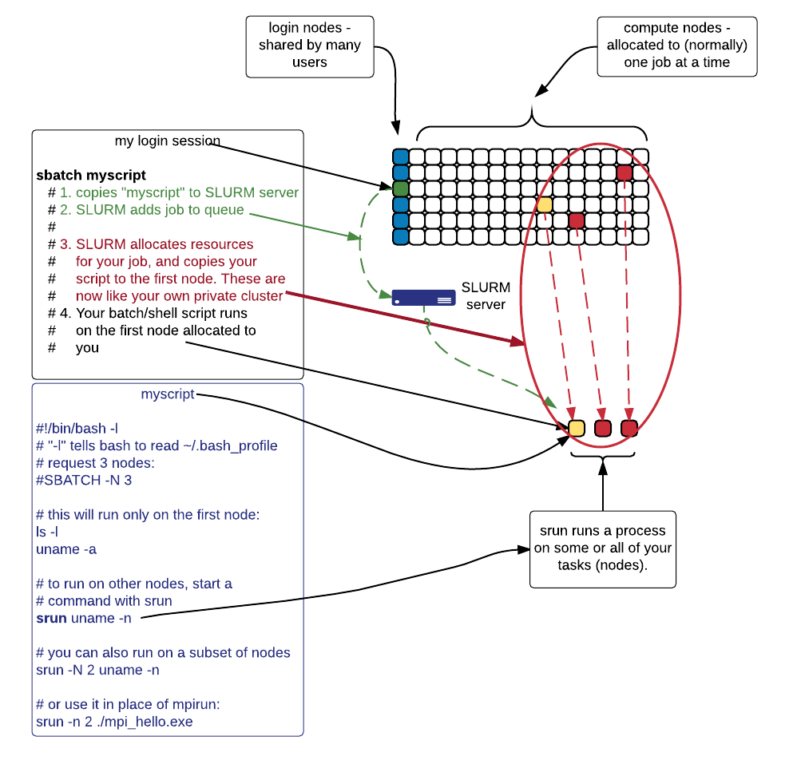
How jobs work
Start on login node
shared by many users,
not for computational work
Access compute nodes with sbatch or salloc
Batch script
Copied to queue
Has directives for SLURM, and shell
commands to perform on ﬁrst compute node
Access your other allocated nodes with srun
stdout, stderr saved to ﬁle
(when running in batch mode)

Slide 25
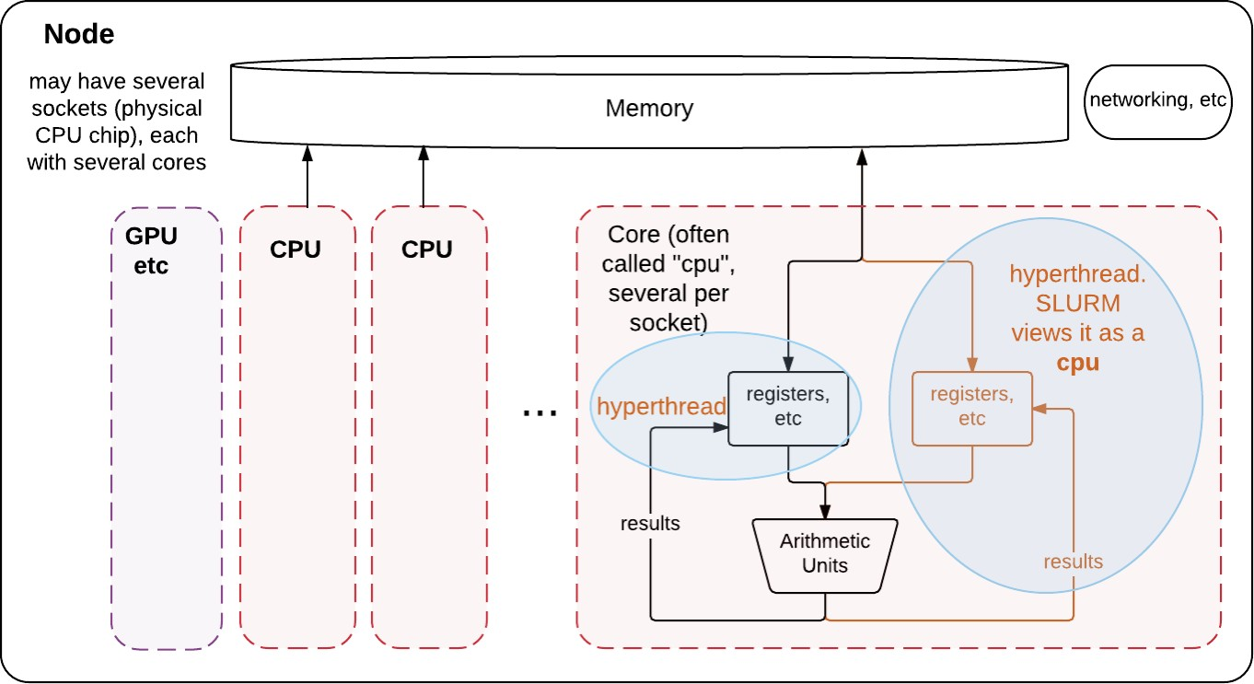
Nodes, cores, CPUs, threads, tasks - some definitions
Node is the basic unit of allocation at NERSC
Think “one host” or “one server”
Single memory space, multiple CPU cores (24 or 32 or 68 ...
And a core might support hyperthreading

Slide 26
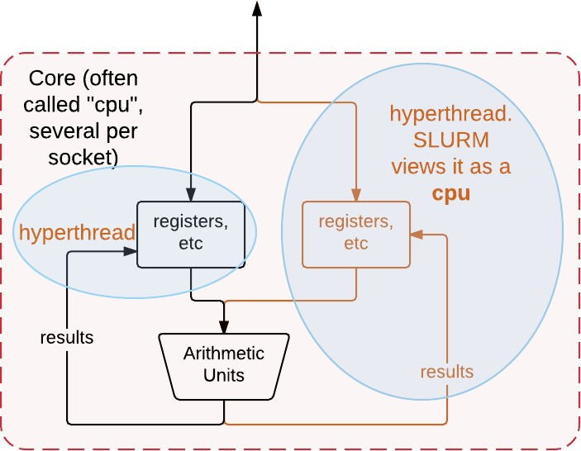
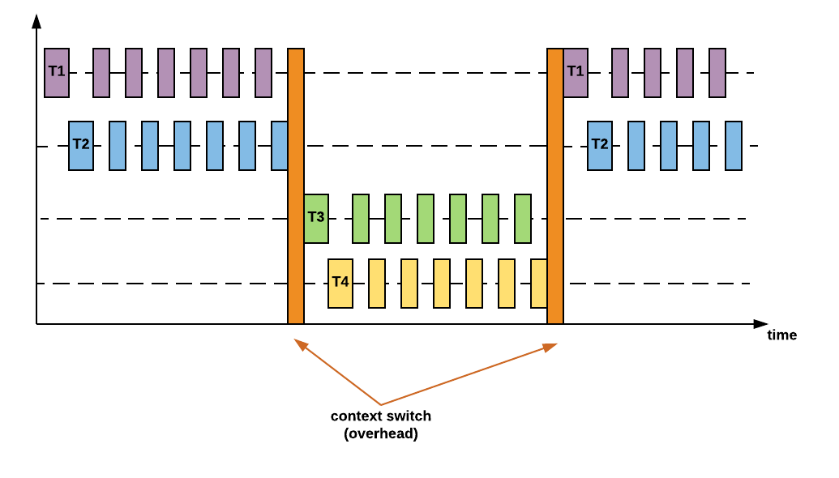
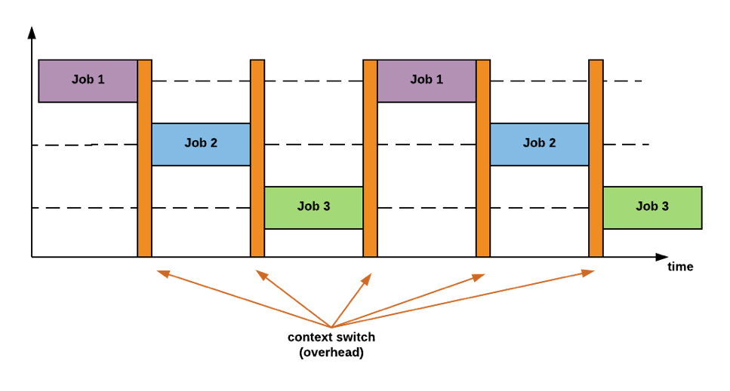
Nodes, cores, CPUs, threads, tasks - some definitions
Hyperthreading
Fast timeslicing
– Good when arithmetic units frequently wait on memory
Core holds state of 2 (4 on KNL) processes, they share arithmetic units
SLURM views each hyperthread as a CPU
But most HPC jobs perform best when not sharing a core!
Usually best to reserve 2 (or 4) CPUs / core
Without hyperthreading
With hyperthreading

Slide 27
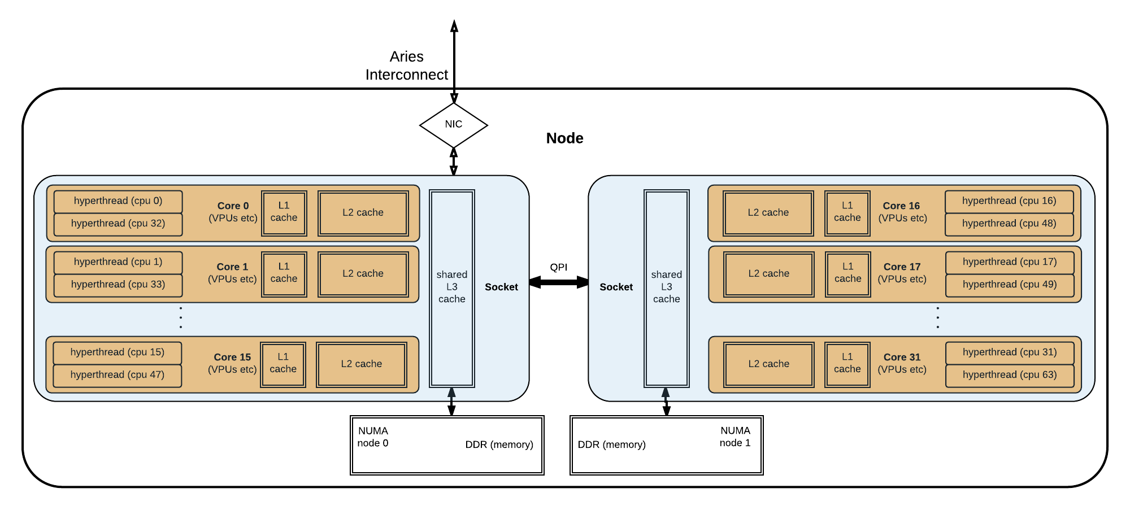
Slurm tasks
First, a block diagram of how hyperthreads, cores, cache, and sockets relate within a (haswell) node

Slide 28
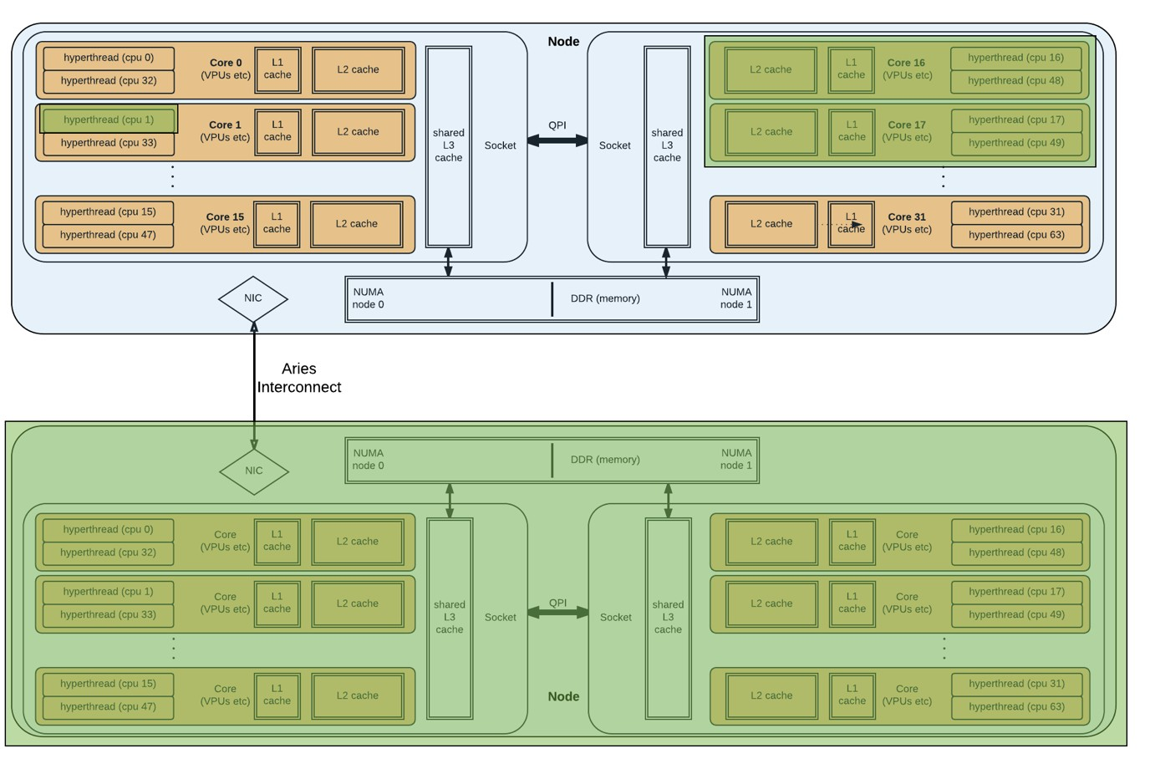
Slurm tasks
A SLURM task is a reservation of CPUs and memory, up to one full node
A job has many tasks
1 task typically
corresponds to 1 MPI rank
srun -n <ntasks> ..
Eg: 3 possible tasks on 2 nodes

Slide 29
So what must I request for my job?
What the batch system needs to know:
How many nodes (or CPUs or tasks) does this job need?
For how long does it need them?
Wallclock time limit
NERSC-speciﬁc extras:
What type of CPU? (-C …)
KNL or Xeon (haswell/ivybridge)?
Which ﬁlesystems will this job use? (-L …)
Usually SCRATCH

Slide 30
Requesting nodes or tasks
#SBATCH -N 64
srun -N 32 ./my_app
# request 64 nodes
# start ./my_app on 32 of them # (default: 1 per node)
srun -n 128 ./my_app # start 128 instances of ./my_app,
# across my 64 nodes (default is # to evenly distribute them in
# block fashion)
Task 0: ./my_app
Task 1: ./my_app
Node 0
Task 2: ./my_app
Task 3: ./my_app
Node 1
Task 126: ./my_app
Task 127: ./my_app
Node 63
One MPI rank generally corresponds to one SLURM Task

Slide 31
Requesting time
#SBATCH | -t | 30 | # | 30 minutes
#SBATCH | -t | 30:00 | # | 30 minutes
#SBATCH | -t | 1:00:00 | # | 1 hour
#SBATCH | -t | 1-0 | # | 1 day
#SBATCH | -t | 1-12 | # | 1.5 days
Wallclock time, ie real elapsed time
Aper this much time, SLURM can kill this job

Slide 32
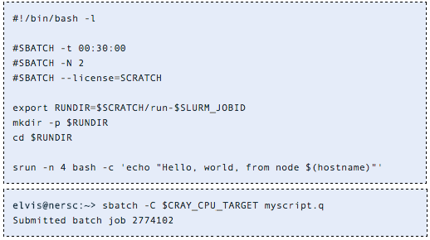
Hands-on exercise: My first job
A SLURM job script has two sections:
Directives telling SLURM what you would like it to do with this job
The script itself - shell commands to run on the ﬁrst compute node
For how long?
How many nodes?
$SCRATCH
ﬁlesystem

Slide 33
Hands-on exercise: My first job
A SLURM job script has two sections:
Directives telling SLURM what you would like it to do with this job
The script itself - shell commands to run on the ﬁrst compute node
Make starting environment like my login environment
Run from
$SCRATCH
Start 4 tasks across my nodes
“sbatch” submits a job script
Notes:
-C, --constraint=<list>Nodes can have features assigned to them by the Slurm administrator. Users can specify which of these features are required by their job using the constraint option. Only nodes having features matching the job constraints will be used to satisfy the request. Multiple constraints may be specified with AND, OR, matching OR, resource counts, etc. (some operators are not supported on all system types). Supported constraint options include:

Slide 34
Running jobs – key points
HPC work is via batch system
Dedicated subset of compute resources
Login nodes are shared resource for building code, editing scripts, etc. Use batch jobs for real work
Key commands:
sbatch / salloc - submit a job
srun - start an (optionally MPI) application within a job
sqs - check the queue for my job status
www.nersc.gov/users/computational-systems/cori/running-jobs/

Slide 35
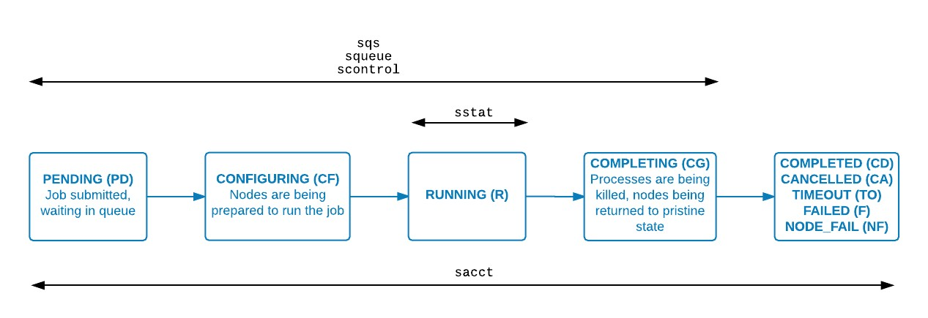
Where is my job?
elvis@nersc:~> sqs
JOBID ST REASON USER NAME
NODES USED REQUESTED ...
2774102 R Prolog elvis myscript.q 2 0:00 30:00
... SUBMIT PARTITION RANK_P RANK_BF
2016-11-18T11:24:20 debug N/A
elvis@nersc:~> ls -lt total 11280
-rw-r----- 1 elvis elvis 132 Nov 18 11:24 slurm-2774102.out
-rw-r----- 1 elvis elvis 208 Nov 18 11:24 myscript.q
N/A

Slide 36
Agenda
Cori overview, logging in
Run a simple job
Building and running applications on Cori
Serial
Parallel (MPI)
Multithreaded (OpenMP)
What aﬀects performance?
Bottlenecks
Task placement and aﬃnity
Preparing for performance analysis

Slide 37
Building and running applications on Cori

Slide 38
Cray compiler wrappers, ftn, cc and CC
Building code optimally for Cori requires a complex set of compiler option and libraries
eg, static linking by default (important for performance at scale)
Compiler wrappers ftn, cc and CC manage this complexity for you
Using environment variables set by the modules you have loaded
Also provide MPI (so eg mpicc is not required)
- 39 -

Slide 39
Wait .. “environment modules” ?
Software on Cori (and most HPC systems) is managed with “environment modules”
Why?
Cori is a shared resource
Diﬀerent people need diﬀerent combinations of sorware, at diﬀerent versions, with diﬀerent dependencies (and for diﬀerent jobs)
Loading and unloading a module updates environment variables (eg $PATH,
$LD_LIBRARY_PATH) to make a package available

Slide 40
Module Commands
module load <modulename>
Add the module from your environment
module unload <modulename>
Remove the module from your environment
module swap <module1> <module2>
Unload one module and replace it with another
% module swap intel intel/16.0.3.210
(replace current default to a speciﬁc version)
module list
See what modules you have loaded right now
module show <modulename>
See what the module actually does
module help <modulename>
Get more information about the sorware
- 41 -

Slide 41
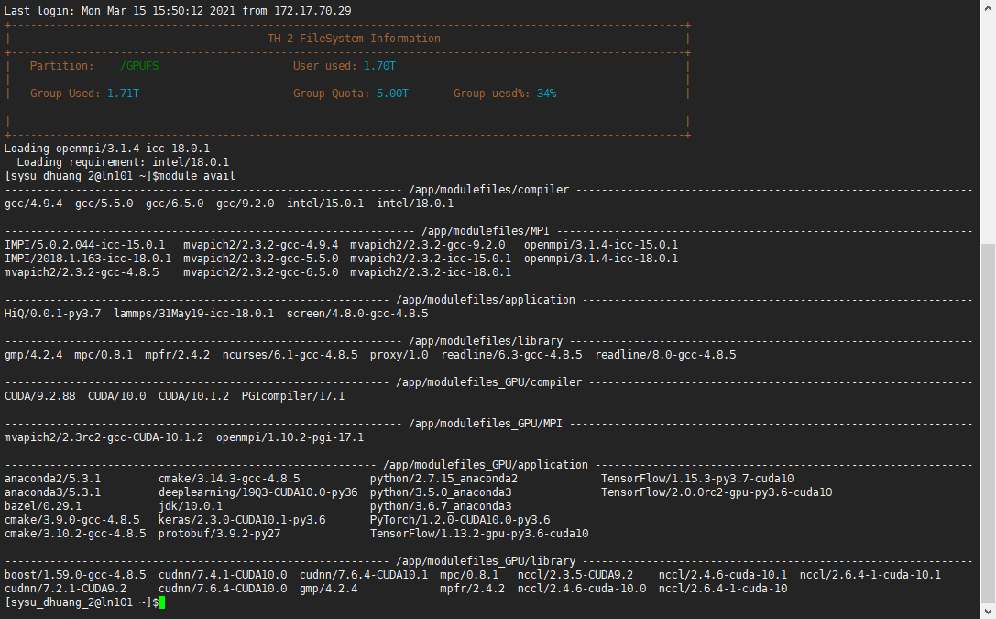
module avail

Slide 42
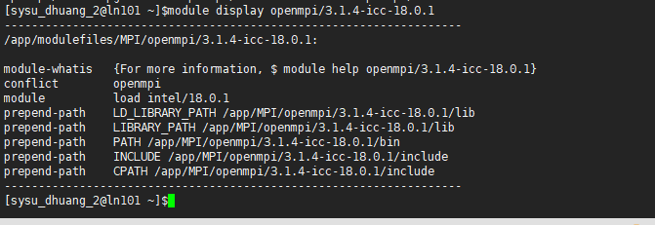
module display

Slide 43
Key modules for compiling
PrgEnv-intel / PrgEnv-cray / PrgEnv-gnu
Which underlying compiler the wrappers should invoke
craype-haswell / craype-mic-knl
Remember, login nodes are haswell, but we are building for KNL!
module swap craype-haswell craype-mic-knl
Wrappers manage cross-compiling
Important for today!

Slide 44
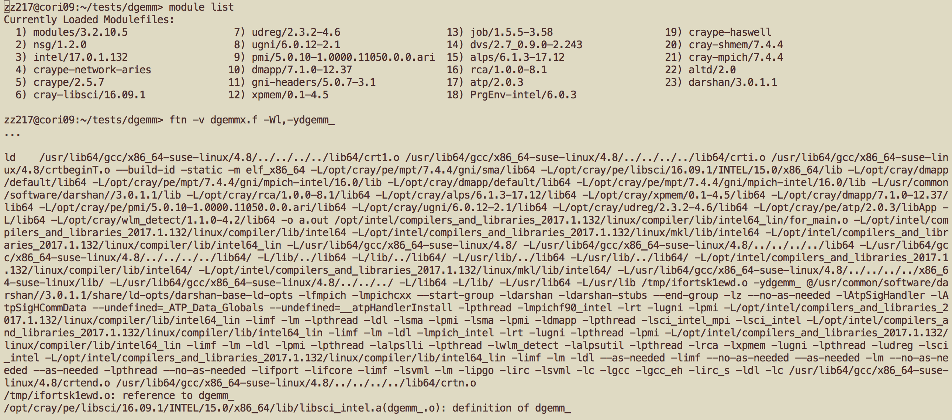
What do compiler wrappers link by default?
Depending on the modules loaded, MPI, LAPACK/BLAS/ ScaLAPACK libraries, and more
- 43 -

Slide 45
Compiling code
Very similar to regular Linux, but using CC / cc / pn
Do this bit once:
module swap craype-haswell craype-mic-knl
Then:
ftn –c hack-a-kernel.f90
ftn –o hack-a-kernel.ex hack-a-kernel.o
Note that the module looks aper CPU target!

Slide 46
Compiling parallel code
Compiler wrappers give you MPI “for free”
CC –c hello-mpi.c++
CC –o hello-mpi.ex hello-mpi.o
(Cray MPICH – optimized for Aries HSN)
OpenMP: with PrgEnv-intel (NERSC default):
cc | –qopenmp | –c | hello-omp.c
cc | –qopenmp | –o | hello-omp.ex | hello-omp.o

Slide 47
MPI vs OpenMP
MPI provides explicit communication between separate processes
Optionally on separate nodes – ie packets over a network
Most parallel development in last 2 decades has used this approach
OpenMP provides work-sharing and synchronization between threads in a single process
Threads share the same address space
To make the most of a KNL node, most applications will need to use OpenMP

Slide 48
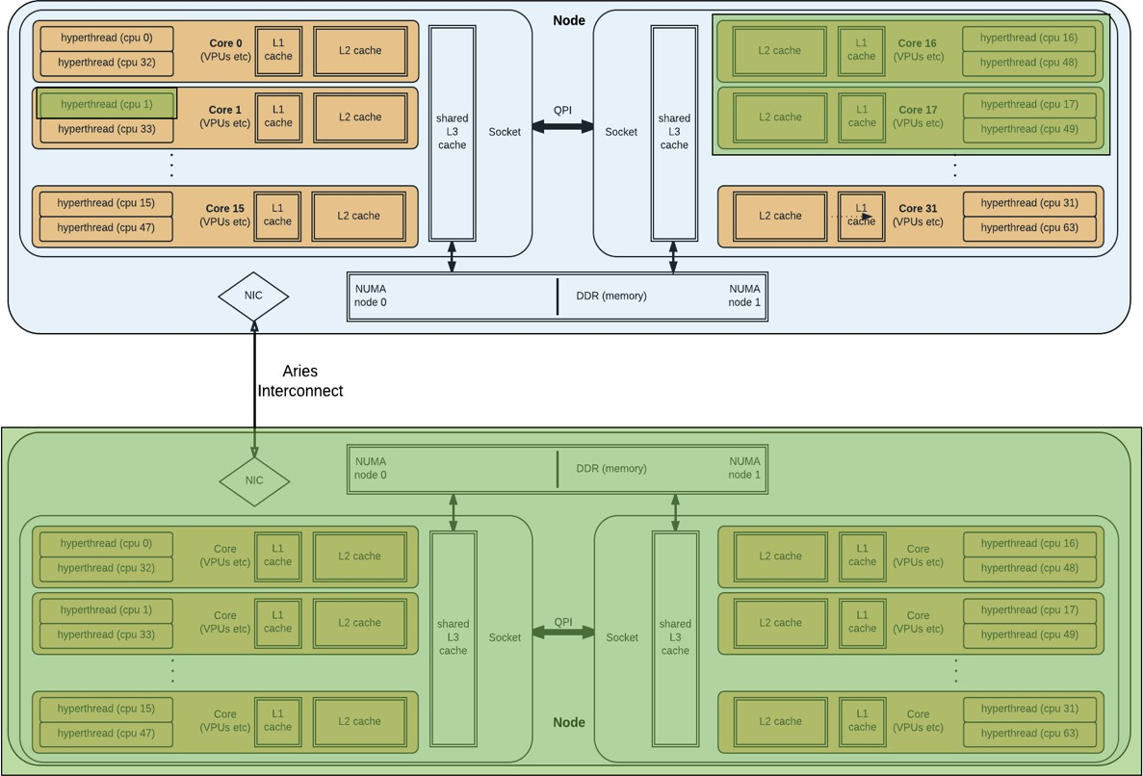
MPI vs OpenMP
An MPI application can have processes on more than one node
An OpenMP application exists entirely within 1 node
OpenMP thread 0
OpenMP thread 1
MPI rank 0
Node 0
MPI rank 1
Node 1

Slide 49
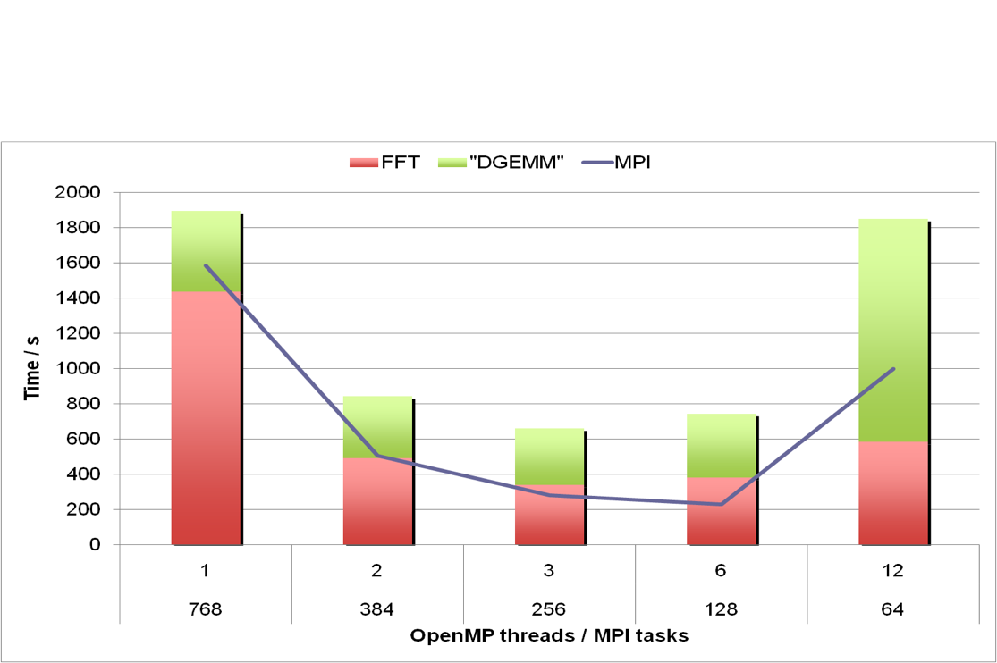
Why do we suddenly need OpenMP?
Multi-level parallelism
At very large scale, the overheads of MPI (or any parallel approach) become excessively costly
Combining (nesting) parallel approaches allows us to operate each at moderate scale
Sweet spot for best overall eﬃciency
MPI -> OpenMP -> Vectorization

Slide 50
Why do we suddenly need OpenMP?
Memory-per-core is trending downwards
Cori Haswell: 128GB for 32 cores
Cori KNL: 96GB for 68 cores (16GB MCDRAM for 68 cores)
Parallelism within same memory footprint 内存占用空间 is necessary

Slide 51
Agenda
Cori overview, logging in
Run a simple job
Building and running applications on Cori
Serial
Parallel (MPI)
Multithreaded (OpenMP)
What aﬀects performance?
Bottlenecks
Task placement and aﬃnity
Preparing for performance analysis

Slide 52
What affects performance?
用得好

Slide 53
Performance bottlenecks
Any point at which some component of the system or application is stalled, waiting on some other component, is a bottleneck
Eg waiting for MPI call to complete
Load imbalance or communication overhead is a bottleneck
BUT for today we are interested in KNL speciﬁcs
Bottlenecks within the node

Slide 54
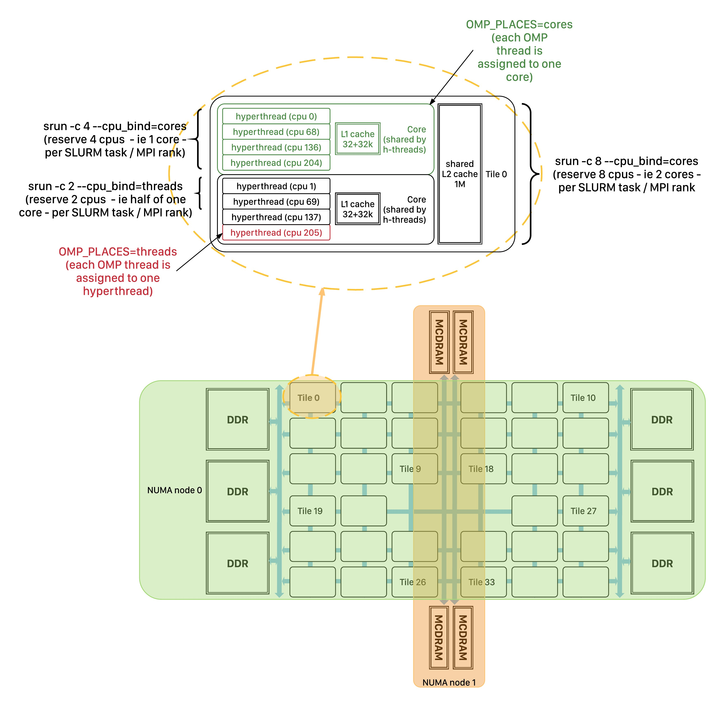
Bottlenecks within the node – Affinity issues
Firstly: Am I running it right?
Cori KNL has 68 cores per node, arranged on a mesh of 34 tiles
Each tile has 2 cores and a shared L2 cache
Each core has 4 hyperthreads sharing an L1 cache

Slide 55
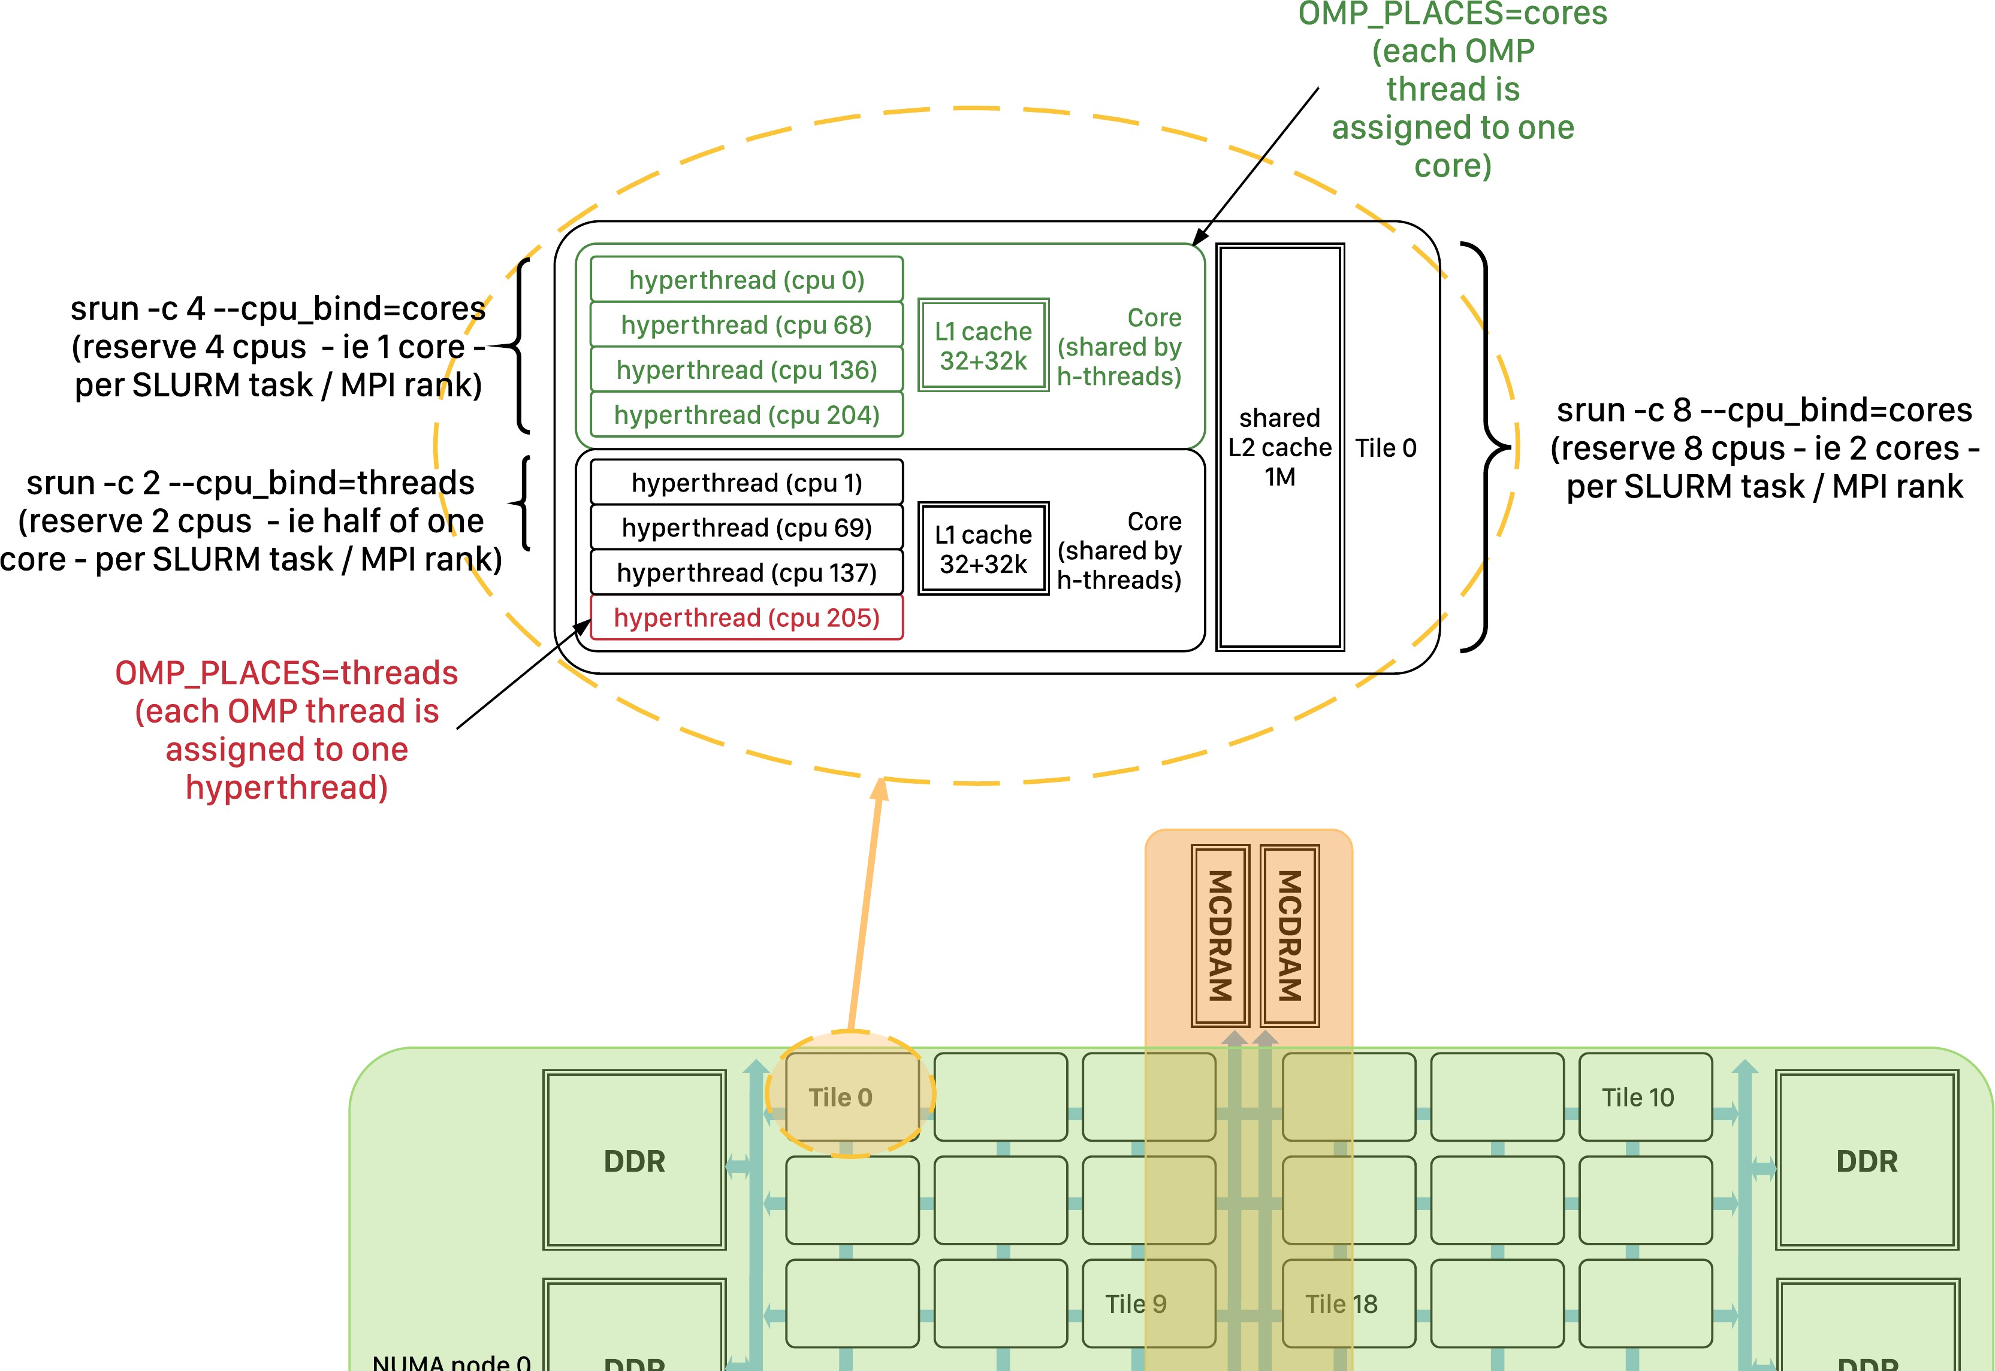
Bottlenecks within the node – Affinity issues
Where are my threads?
Is each using a diﬀerent core at least?
Linux does not always choose best placement
Use srun options to ensure optimal thread/process placement

Slide 56
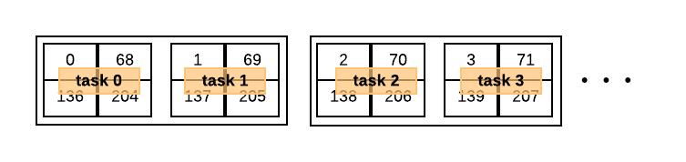
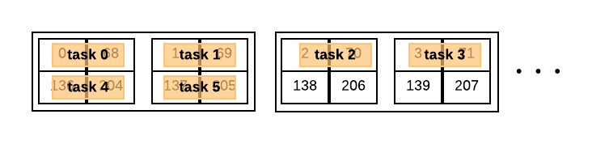
Process (task) affinity
Solution: use --cpu_bind:
srun -n 64 -c 4 --cpu_bind=verbose,cores ./my_exec srun -n 128 -c 2 --cpu_bind=verbose,threads ./my_exec
Controls what a task (MPI rank) is bound to
– If no more than 1 MPI rank per core: --cpu_bind=cores
– If more than 1 MPI rank per core: --cpu_bind=threads
Notes:
-c, --cpus-per-task=<ncpus>Request that ncpus be allocated per process. This may be useful if the job is multithreaded and requires more than one CPU per task for optimal performance. The default is one CPU per process. If -c is specified without -n, as many tasks will be allocated per node as possible while satisfying the -c restriction. For instance on a cluster with 8 CPUs per node, a job request for 4 nodes and 3 CPUs per task may be allocated 3 or 6 CPUs per node (1 or 2 tasks per node) depending upon resource consumption by other jobs. Such a job may be unable to execute more than a total of 4 tasks.WARNING: There are configurations and options interpreted differently by job and job step requests which can result in inconsistencies for this option. For example srun -c2 --threads-per-core=1 prog may allocate two cores for the job, but if each of those cores contains two threads, the job allocation will include four CPUs. The job step allocation will then launch two threads per CPU for a total of two tasks.

Slide 57
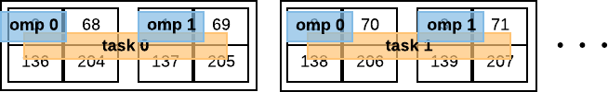
Thread affinity (OpenMP)
export OMP_NUM_THREADS=2 export OMP_PROC_BIND=spread export OMP_PLACES=cores
# or close
# or threads, or sockets
srun -n 32 -c 8 --cpu_bind=verbose,cores ./my_exec
...If using hyperthreads, use OMP_PLACES=threads

Slide 58
Memory affinity
Linux default behavior is to allocate to closest NUMA- node, if possible
Not always optimal:
KNL nodes: DDR is “closer” than MCDRAM
#SBATCH -C knl,quad,flat export OMP_NUM_THREADS=4
srun -n16 -c16 --cpu_bind=cores --mem_bind=map_mem:1 ./a.out
NUMA node 1 is MCDRAM in quad,ﬂat mode
NUMA node 0 is DRAM
“Mandatory” mapping: if using >16GB, malloc will fail
NOTE: today’s reservation is for “cache-mode” nodes, e.g. “quad, cache” so MCDRAM is invisible, the MCDRAM is used as cache so is not considered as a separate NUMA node.

Slide 59
Bottlenecks within the node – Affinity issues
OMP_PROC_BIND=true OMP_PLACES=cores (threads) srun -c 4 --cpu_bind=cores …
Cache coherence
False sharing
Inter NUMA-node data access
………

Slide 60




Bottlenecks within the node
Performance tends to be dominated by:
Doing arithmetic operations
(# FLOPS/cycle)
Moving data between arithmetic units and memory
Bottlenecks are usually due to one of these parts waiting on the other

Slide 61
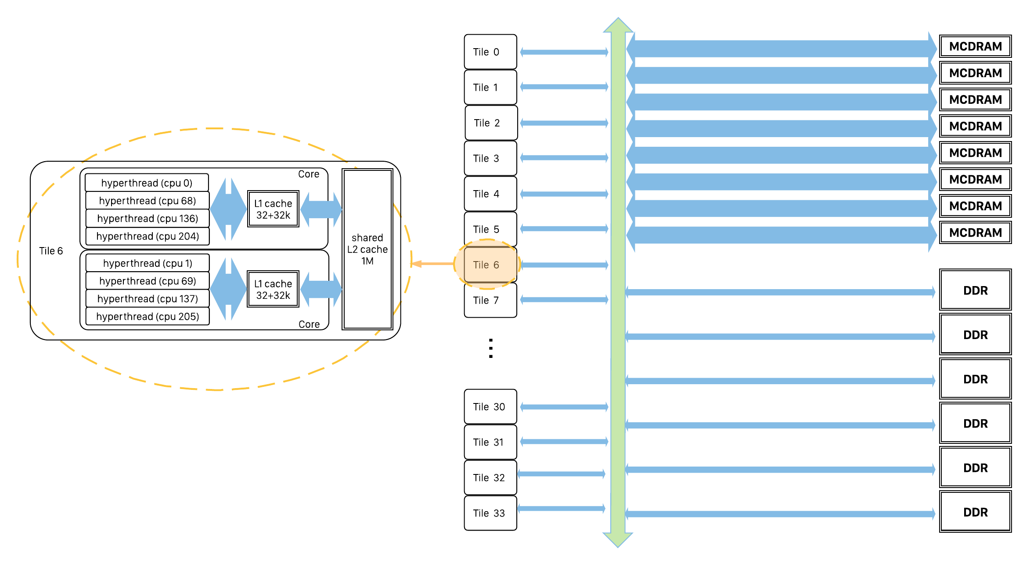
Bottlenecks within the node
Bandwidth!
MCDRAM is very high bandwidth (~450 GB/s)
.. But aggregate bandwidth is not the same as bandwidth to each core!

Slide 62
Agenda
Cori overview, logging in
Run a simple job
Building and running applications on Cori
Serial
Parallel (MPI)
Multithreaded (OpenMP)
What aﬀects performance?
Bottlenecks
Task placement and aﬃnity
Preparing for performance analysis

Slide 63
Preparing for performance analysis

Slide 64





Profiling prerequisite
A small, short, but representative test case for your application
Proﬁling tends to be costly
Runtime overhead
Size of data collected
BUT: must cover same paths through code as “real” example (or at least, the diﬀerences must be understood)
What could go wrong with this test case?
Real run:
time-stepping
setup
output
Test case for proﬁling:
1 timestep
- 65 -

Slide 65
…But my application just is big!
Start with a low-overhead proﬁling method
Eg sampling-based (gprof, TAU, CrayPat, …)
Identify hotspots
Only proﬁle part of a run
Some tools (eg Vtune) allow you to start the run “paused” and “resume collection” via an API call
Only proﬁle 1 MPI rank
Via srun options, eg run Vtune on one rank, not others (beyond today’s scope)
Luckily, our hack-a-kernel is already small! ☺

Slide 66
Performance Analysis Gotchas
Many tools require dynamically-linked executable
Including Vtune
NERSC/Cray: applications are statically linked by default, must use “-dynamic” at compile time
“Uncore” (eg memory related) performance counters usually require special permissions (eg kernel module)
NERSC/Slurm supports this with #SBATCH –perf=vtune
directive

Slide 67
Summary and Recap
Now you can:
Log in
Build an application
Run an application, and be aware of how and where it is running
Prepare an application for performance analysis with Vtune
Q & A?

